Slide 1
Annotation - DI

Slide 2
Quickstart
Spring container needs POJOs and configuration / wiring instructions to assemble your application
Wiring instructions can be provided
in XML…
… using annotations…
…or a combination of the two

Slide 3
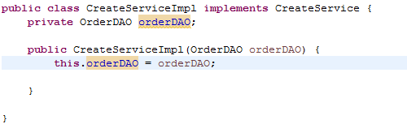
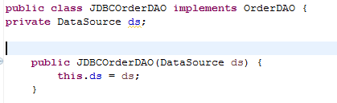
Beans that we have seen

Slide 4
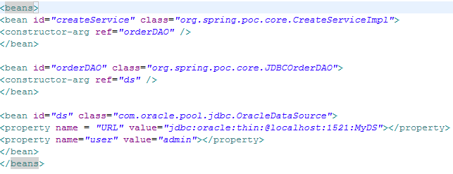
Corresponding xml configuration

Slide 5
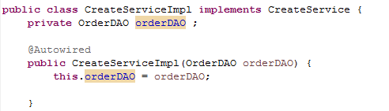
With the annotation way
Spring will automatically wire the dependency

Slide 6
Annotation Based approach
<bean id=“createService” class=“org.spring.poc.core.CreateServiceImpl” />
<bean id=“orderDAO” class=“org.spring.poc.core.JDBCOrderDAO”/>
Need not specify dependency through constructor args

Slide 7
Annotations used in Configuration
@Autowired
@Resource
@Component / @Repository
@PostConstruct / @PreDestroy / @Required

Slide 8
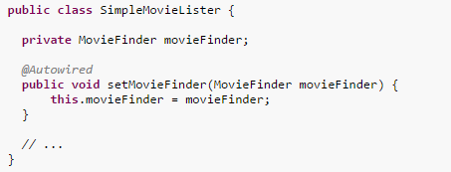
@Autowired
The @Autowired annotation tells spring where an injection needs to occur.
If you put it on a method setMovieFinder it understands (by the prefix set + the @Autowired annotation) that a bean needs to be injected.
searches for a bean of type MovieFinder, if it finds such bean, it injects it to this method.

Slide 9
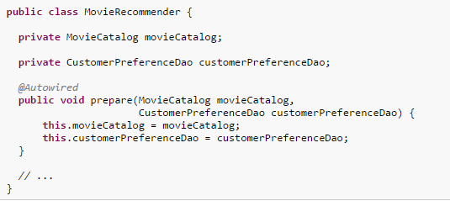
@Autowired
Methods can have any name
Methods and constructors can have multiple arguments that will all be injected
Notes:
Without using any other annotations, @Autowired can autowire a constructor, field, or method by type. TheAutowiredAnnotationBeanPostProcessor must be registered with either the BeanFactory or ApplicationContext to have annotation-based autowiring on beans work. This bean post processor is implicitly registered by context:component-scan and context:annotation-config. Both of which will be covered in more detail in the following section.
When @Autowired is unable to find at least one match, a BeanCreationException will be thrown. By default it required that it autowires at least one value, but this can be changed by setting @Autowired(required=false). If more than one match is found when matching by type and it isn't an array or Collection class, a BeanCreationException will be thrown. If there is one bean that should be selected out of many of the same type, the bean element's primary attribute can be set to true. This will let autowiring by type pick a unique bean from a list of beans that are all the same type. There must be only one bean marked as the primary bean for a type or an exception will still be thrown.
One or more parameters can be autowired for a constructor or method. Only one constructor can be marked as required, although more than one can be set as autowired. If there is more than one constructor marked as autowired, Spring will use the constructor that can have the most arguments matched based on the beans in the IoC container and the autowiring rules.
Ref : springindepth.com

Slide 10
@Autowired for Collections
Just include a typed Collection to obtain a reference to all beans of a certain type
Injects all beans of type OrderDAO
available in the ApplicationContext
public class CreateServiceImpl implements CreateService
@Autowired
public CreateServiceImpl(List<OrderDAO> daos) {
this.daos = daos;
}
…
}

Slide 11
Optional@Autowired
Using the required element, specify whether or not Spring should fail if no instance was found
Defaults to true
@Autowired(required=false)
private OrderDAO orderDAO;
Provides nice way of specifying defaults
@Autowired(required=false)
private OrderDAO orderDAO =
new DefaultOrderDAOImpl();

Slide 12
Resolving Ambiguity with @Autowired
If multiple beans of the same class exist,you get an exception.
In order to avoid the exception you can use the @Qualifier annotation and tell it which of the beans to inject
@Autowired
@Qualifier(“primaryDataSource”)
private DataSource dataSource;
Notes:
Spring tries to autowire by type. Only one bean of that type should exist. If multiple beans of the same type exist, an exception occurs. To resolve, provide a qualifier to specify the name of the bean tht has to be autowired

Slide 13
@Resource(“myBeanName”)
If you don't want to use 2 annotations (the @Autowired and @Qualifier) you can use @Resource to combine these 2:
@Resource is JSR-250 Annotation and not Spring Specific
@Resource(“primaryDataSource”)
private DataSource dataSource;

Slide 14
Good practice
Use @Inject instead of @Autowired because it is not spring-specfic and is part of the JSR-330 standard.
Put @Inject / @Autowired on a constructor instead of a method
(If you put it on a constructor, spring validates such bean exists before injection. In the method way it injects null if it can't find the bean you need which will cause a NullPointerException when you try to use this bean instead of a descriptive exception in the first time you start your app)

Slide 15
For the annotations to work
We need to enable them
<beans xmlns="http://www.springframework.org/schema/beans"
xmlns:xsi="http://www.w3.org/2001/XMLSchema-instance"
xmlns:context="http://www.springframework.org/schema/context"
xsi:schemaLocation="http://www.springframework.org/schema/beans
http://www.springframework.org/schema/beans/spring-beans-2.5.xsd
http://www.springframework.org/schema/context
http://www.springframework.org/schema/context/spring-context-2.5.xsd">
<context:annotation-config/>
<bean id=“createService” class=“org.poc.service.createServiceImpl”/>
<bean id=“orderDAO” class=“org.poc.dao.JdbcOrderDAO”/>
</beans>
Turns on checking of DI
annotations for beans declared
in this context

Slide 16
@Component
Identifies POJOs as Spring Beans
Removes the need to specify almost anything in XML
Optionally pass it a String, which will be the bean name
Default bean name is de-capitalized non-qualified name
@Component
public class CreateServiceImpl implements CreateService
@Autowired
public CreateServiceImpl(OrderDAO orderDao) {
this.orderDao = orderDao;
}
…
}
The bean name for this bean would be ‘createServiceImpl’

Slide 17
@Component name
@Component takes a String that names the bean
@Component(“myCreateService”)
public class CreateServiceImpl implements CreateService
@Autowired
public CreateServiceImpl(OrderDAO orderDAO) {
this.orderDAO = orderDAO;
}
…
}
Multiple beans with the same name are not allowed by the Spring container

Slide 18
For the annotation to work
<beans xmlns="http://www.springframework.org/schema/beans”
xmlns:xsi="http://www.w3.org/2001/XMLSchema-instance"
xmlns:context="http://www.springframework.org/schema/context"
xsi:schemaLocation="http://www.springframework.org/schema/beans
http://www.springframework.org/schema/beans/spring-beans-2.5.xsd
http://www.springframework.org/schema/context
http://www.springframework.org/schema/context/spring-context-2.5.xsd">
<context:component-scan base-package=“com.poc.spring”/>
</beans>
No more need to mention the
beans in the application context

Slide 19
@Scope
Specify instantiation strategy
@Scope(“prototype”) @Component
public class CreateServiceImpl implements CreateService
@Autowired
public CreateServiceImpl(OrderDAO orderDAO) {
this.orderDAO = orderDAO;
}
…
}

Slide 20
Including and Excluding beans
Using filters, we can include or exclude beans, based on type or class-level annotation
<context:component-scan base-package=“org.example">
<context:include-filter type="regex"
expression=".*Stub.*Repository"/>
<context:exclude-filter type="annotation"
expression="org.springframework.stereotype.Repository"/>
</context:component-scan>

Slide 21
Junit 4 and @Test Annotation
Junit 4 does not use inheritance and methods prefixed with test
Instead annotate test methods with @Test
Setup - @Before
TearDown - @After
@RunWith – JunitClass runner
@ContextConfiguration – to load context
@Transactional – tests will be run in a transaction and rolled back on completion

Slide 22
In a nutshell
Spring’s configuration directives can be written in XML or using annotations
You can mix and match XML and annotations (xml takes precedence when both are available)
@Autowired and @Component allow for almost empty configuration files
@ContextConfiguration , @Transactional lets you run tests in a transaction

Slide 23
LAB

